Slide 1
Work Update - July 4th
Giulio

Slide 2
Project: co-location of genetic and epigenetic variants
Goals
Study genetic pathways to epimutations
Find examples of causality between genetic and epigenetic variations
QTL studies show causality (Das 2015, Kilpien 2013, McVicker 2013)
Data available -> Variant measured
WGS -> variant calls (VCs)
WGBS -> differentially methylated regions (DMRs)
ChIP-seq -> differential histone modifications (DHMs)
RNA-seq and miRNA-seq -> differentially expressed regions (DEs)
Proposed models for epigenetic regulation in cancers
(1) Mutations in binding domains -| TF binding -| gene expression -> epigenetic regulation change (Matsubara 2012)
(2) Mutation on Cis-regulatory DNA -> epigenetic regulation change
(3) Mutation on Trans-regulatory DNA (ncRNA? 3D chromatin?) -> epigenetic regulation change
(4) Mutation on epigenetic machinery (HATs, HMTs, HDACs, DNMTs, etc) -> global change in epigenetic regulation
Expected scenario for each model
(1) VCs on known regulatory regions are close to DMRs, DHMs and DEs
(2) VCs on all regions are close to DMRs, DHMs and DEs
(3) DMRs, DHMs, and DEs are close to each other without a nearby VC
(4) Tumour samples would have global epigenetic changes independent of local VCs

Slide 3
Model
Models -> Expected outcome
1 Mutations -| TF -> VCs on known regulatory regions are close to DMRs, DHMs and DEs 2 Cis-regulatory DNA -> VCs on all regions are close to DMRs, DHMs and DEs 3 Trans-regulatory DNA -> DMRs, DHMs, and DEs are close to each other without a nearby VC 4 Machinery mutation -> Tumour samples with global epigenetic changes independent of local VCs
4
DNMT
1
2
3
3D conformation
ncRNA
Global demethylation
Methyl (DMR) &
Hist mods (DHM)
TF
Methyl (DMR) &
Hist mods (DHM)
Methyl (DMR) &
Hist mods (DHM)
expression

Slide 4
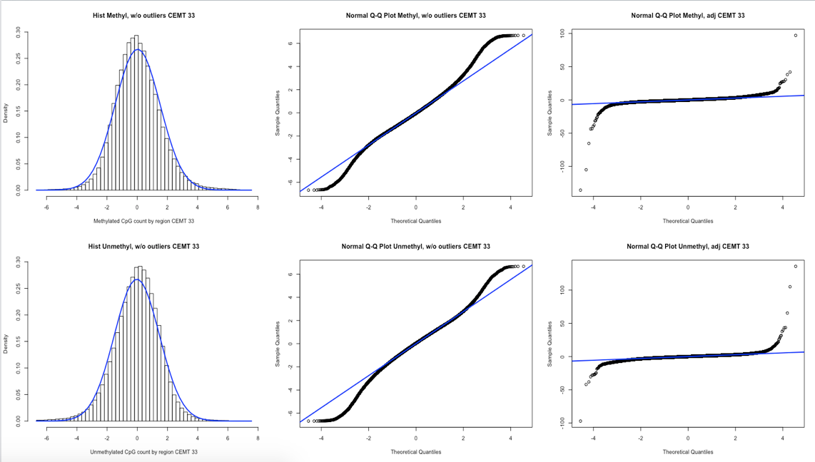
The Analysis
1) Split genome into 400bp chunks - Defined arbitrary regions for contrasting datasets that localize differently - 400bp is small enough to not envelop multiple functionally different regions 2) DMR - 𝜒2 test on methylation calls - Add counts over 400bp region -> enough coverage for 𝜒2 criteria - Adjusted residual approaches a normal distribution with outliers - Adjusted residual = (O - E) / sqrt(E * (1 - prow) * (1 - pcol)) - 𝜒2 finds DMRs within group: - All from same patient -> Test contribution of models with and without cancer - All Normal and Tumour-adjacent samples -> baseline in normal tissue - All Tumour samples -> baseline in cancer tissue 3) DHM - Enriched regions from FindER - BED file with 3 columns: Chromosome | Region Start | Region Stop - Set 1 for genome chunks that overlap with enriched regions listed 4) VCs - query VCFs to list variants - obtain genotypes, zygosity and functional annotation - contrast tumour and normal samples to isolate somatic mutations - count the amount of mutations in each genome 400pb chunk 5) Count VCs close to or within DMRs, DHMs, or both. - Other samples’ VCs serve as statistical baseline - If models 1 and 2 hold, VCs co-locate with DMRs and DHMs, so count is higher than baseline - Analysis shows a connection between DMR and VCs
DMR1 and VCF1:
DMR1 and VCF2:

Slide 5
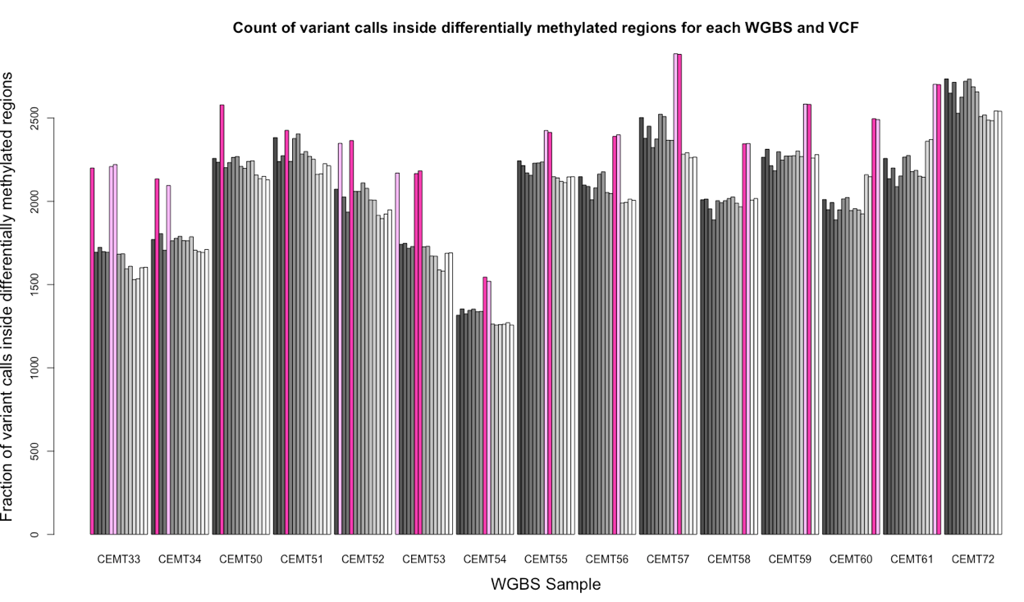
Same sample
Same patient but other sample
Other patient

Slide 6
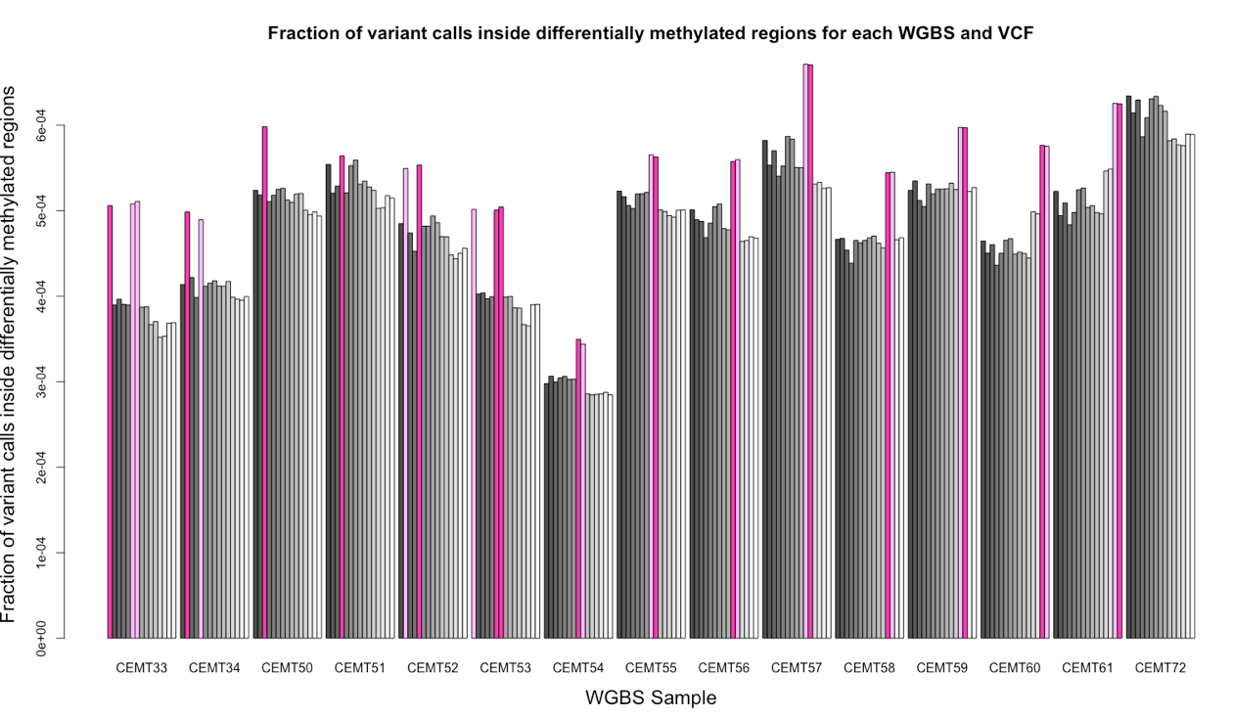
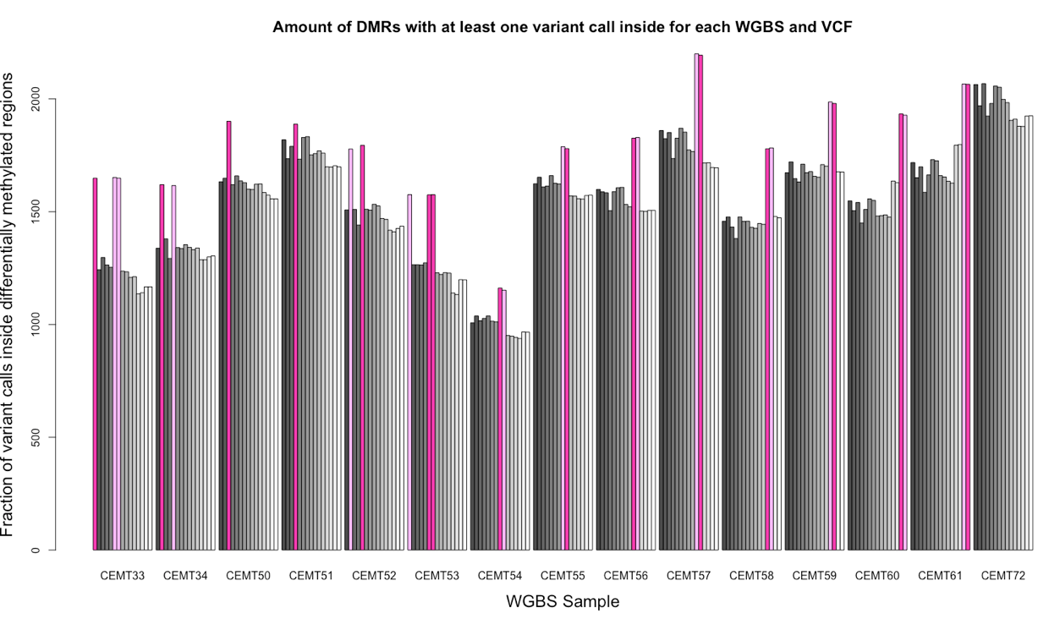
Same sample
Same patient but other sample
Other patient

Slide 7
Same sample
Same patient but other sample
Other patient

Slide 8
Next steps?
Include DHM to improve baseline
Include VCF functional annotation (test models 1 and 2)
Redo with multiple chunk sizes (improve coverage)
Run analysis for each group
All from same patient -> P1 (34, 52, 62), P2 (33, 53, 63), P3 (54, 55, 64), P4 (56, 57, 65), P5 (58, 59, 66), P6 (60, 61, 67)
All Normal and Tumour-adjacent samples -> Norm (33, 34, 52, 53, 54, 55, 56, 57, 58, 59, 60, 61)
All Tumour samples -> Tum (62, 63, 64, 65, 66, 67)
For regions identified, investigate RNA and miRNA expression
How to obtain position from coverage files?

Slide 9
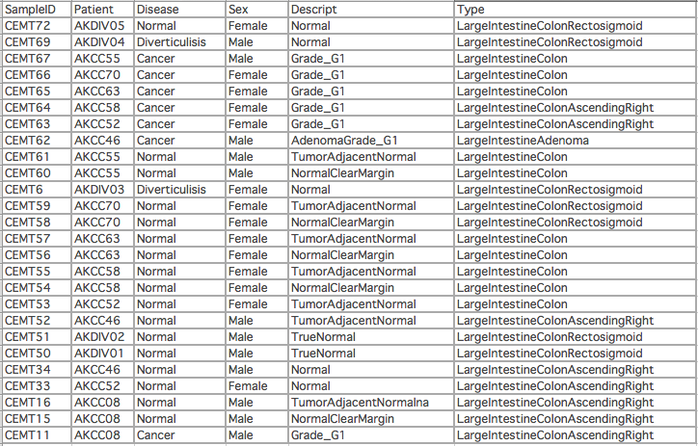

Slide 10
Probing data
By raising the thresholds for DMRs we select for regions where multiple CpGs are regulated differentially, so the biological effects are amplified relative to technical artifacts from VCs confounding WGBS alignment.
As selectivity increases, spatial correlation decreases. Suggests that:
More unique DMRs are not genetically determined
Spatial correlation was likely a technical artifact

Slide 11
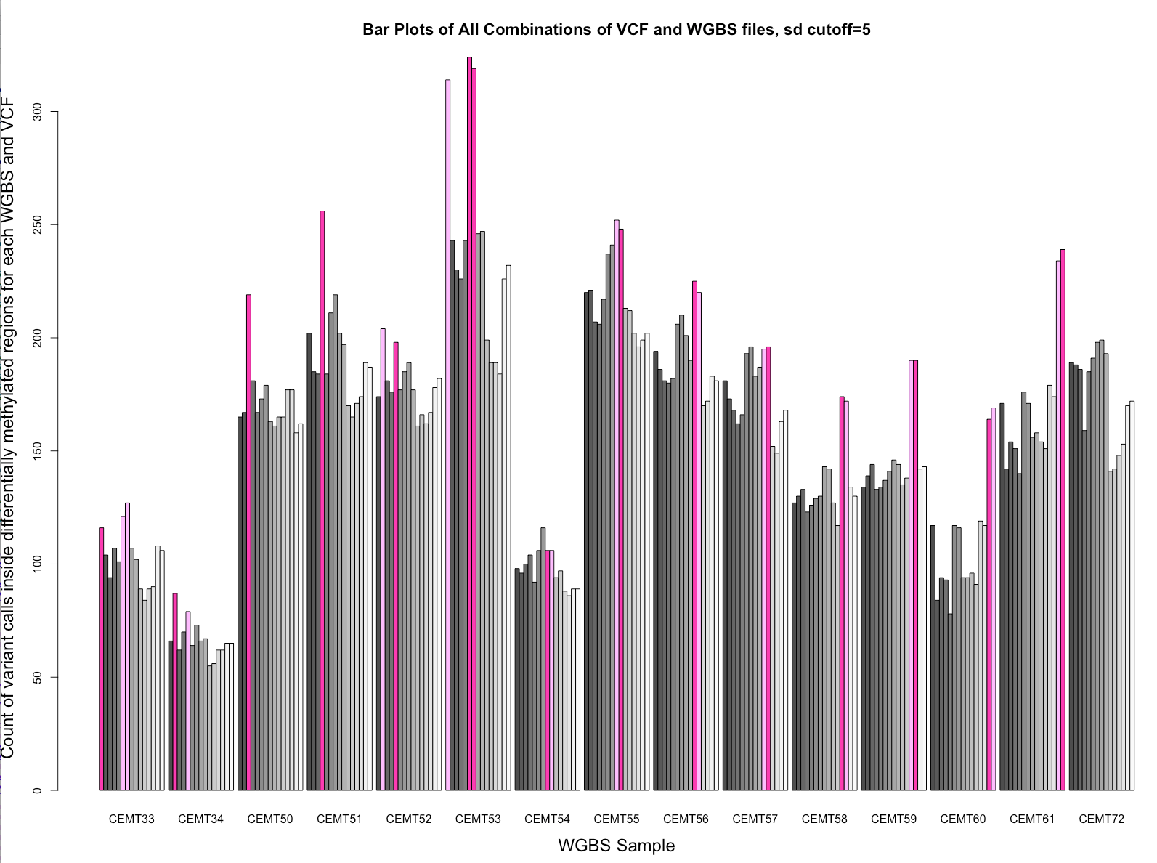
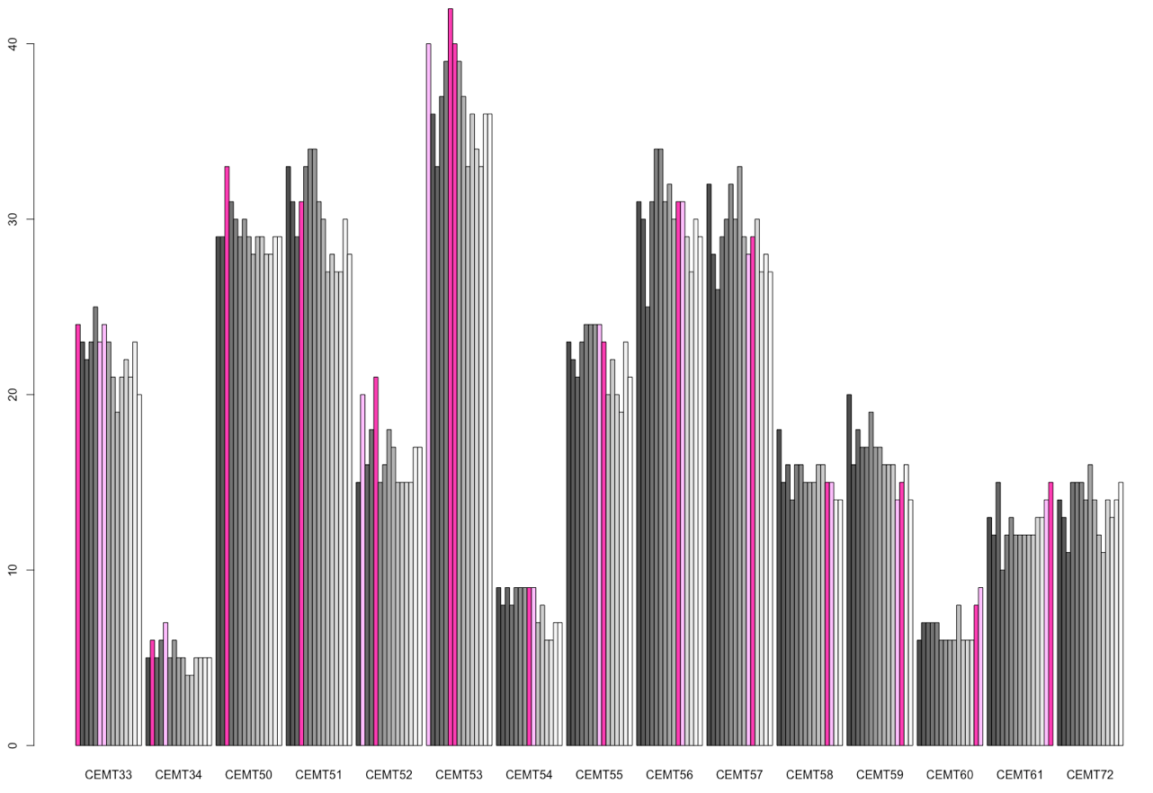
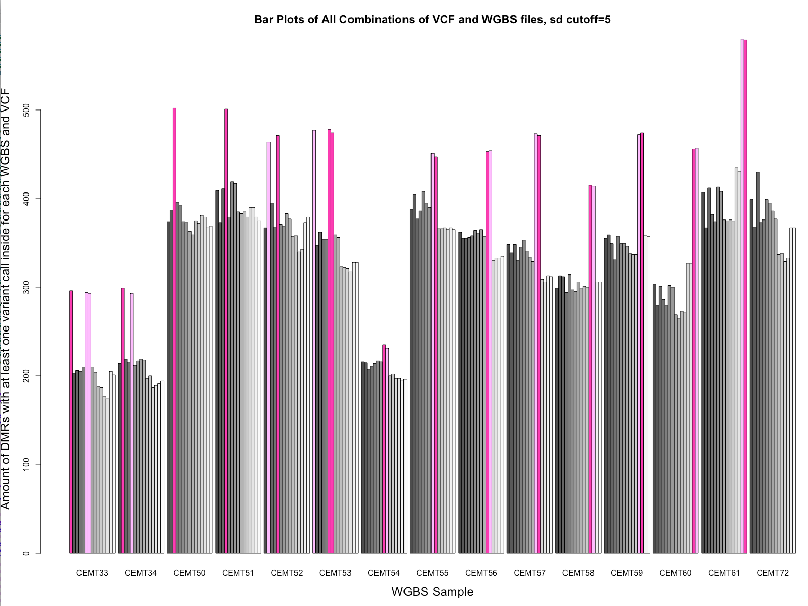
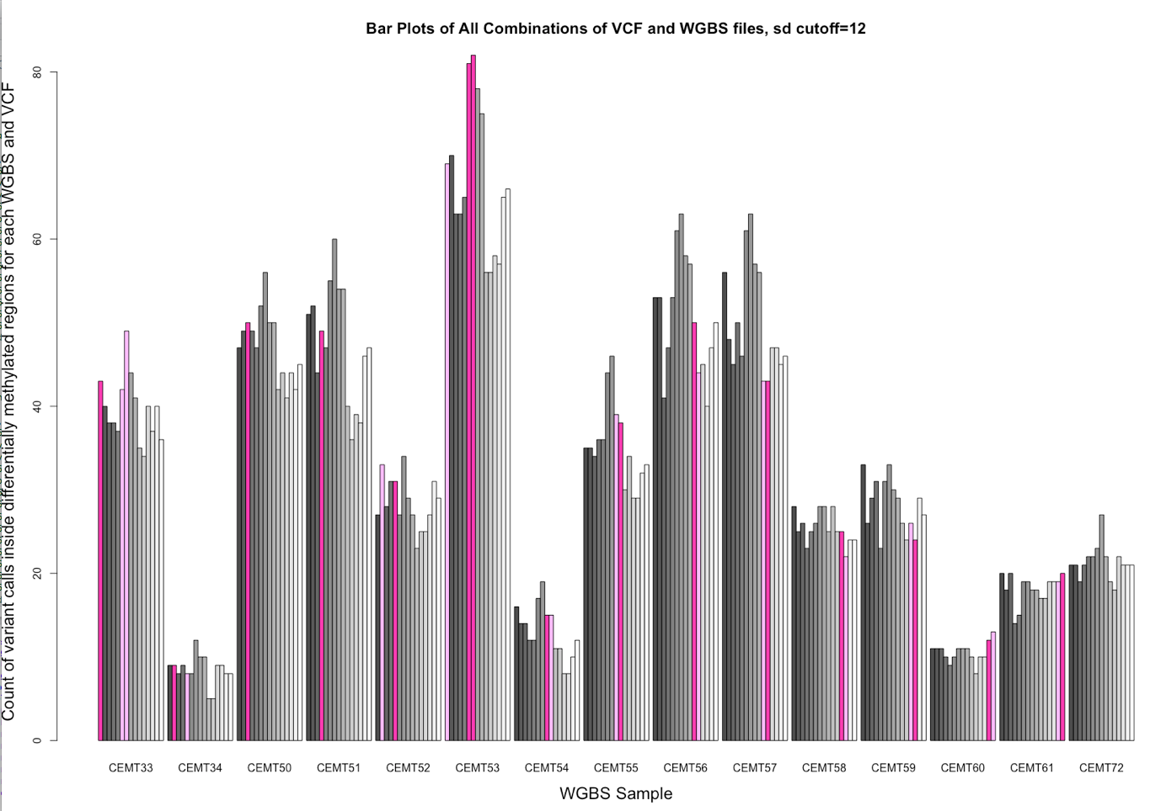
Residual > 1.96*sd
Residual > 5*sd
Residual > 12*sd
Count of VCs inside DMRs
Count of DMRs with a VC inside

Slide 12
QC
File | # Rows
CEMT Methyl BED original data | 58,588,398 - 58,607,722
CEMT 33 Methyl BED non-null | 23,185,884
CEMT 33 VCF | 4,348,573
join of all 15 CEMT Methyl BED | 711,498
DMRs (50bp each) for CEMT33 | 2484 (cov=124,200bp)
Human genome | 3,200,000,000bp
Size probing of regions for methyByRegion on CEMT 33
region=50; rows=5,847,330; coverage=292,366,500
region=100; rows=4,473,868; coverage=447,386,800
region=200; rows=3,117,795; coverage=623,559,000
region=400; rows=3,396,255; coverage=1,358,502,000
region=1000; rows=1,908,876; coverage=1,908,876,000

Slide 13
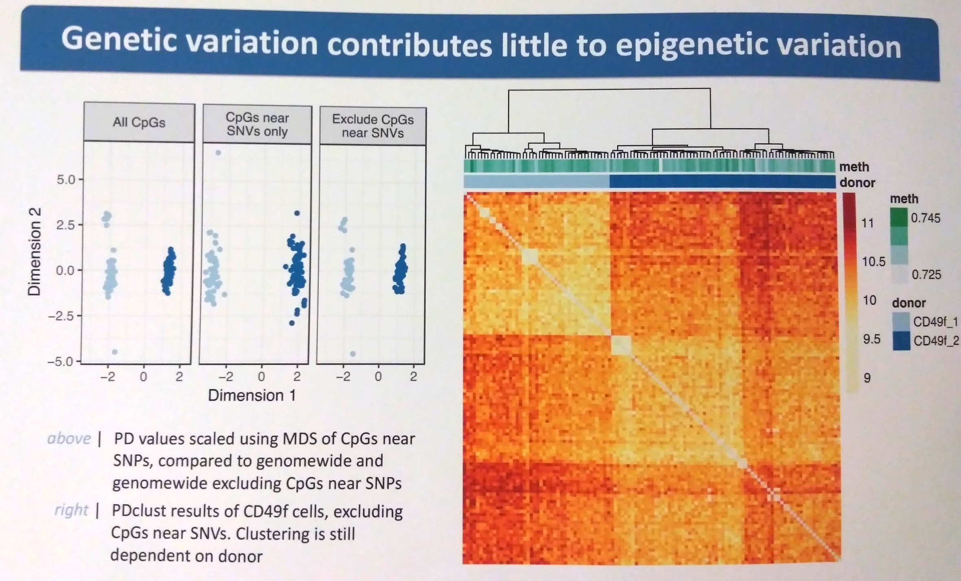
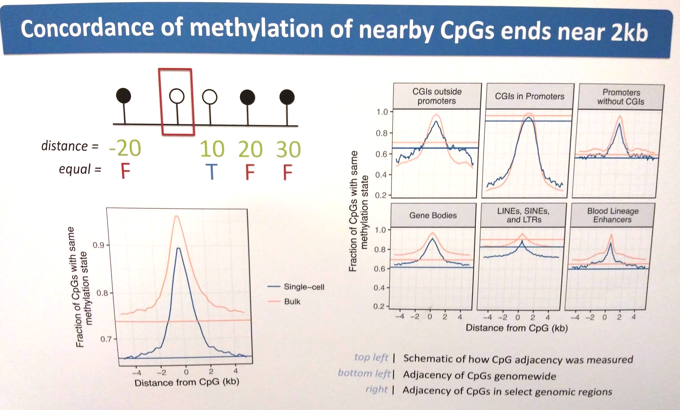
Tony’s analysis: significance of genetic variants from clustering
Concordance affects up to 2kb distance (Tony)
QTLs significantly affect up to 1Mb distance (Zhang 2010)
Toni removed 200bp around genetic variants, but that is unlikely to cover all contributions of a QTL
Also, the fact that clustering occurs by cell type demonstrates other unique patterns, but not that genetic patterns are irrelevant
Still a defining feature, so still contributes to the clustering

